Slide 1

Ad-Tech Platform for
Media Discovery and Planning

Slide 2
CITY
www.excellentpublicity.com

Slide 3
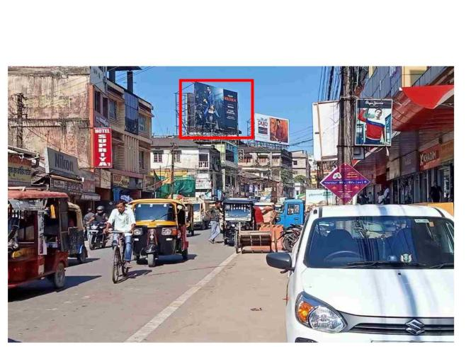
EP Site Code:
Site Visibility Rating:
Average Impression: Dwell Time (Sec): Frequency:
Traffic Cover Route:
Locality Affluence:
Station Road, 30x20 – NL Google Map:
Price:
www.excellentpublicity.com

Slide 4
THANK YOU
Let’s Build Success Together!
www.excellentpublicity.com

